Slide 1

L2
REGULARIZATION

Slide 2
Overfitting in regression models occurs when a model is excessively complex, closely capturing the peculiarities and noise in the training data.
causes of overfitting are too many features,Insufficient samples,mdel complexity,lack of regularization.
OVERFITTING
consequences of overfitting are poor generalization,misleading model evaluation and unreliable predictions.

Slide 3
TYPES OF REGULARIZATION
L1 Regularization
L2 Regularization
Elastic Net Regularization

Slide 4
LET’S TALK ABOUT L2
REGULARIZATION
IN LOGISTIC
REGRESSION

Slide 5
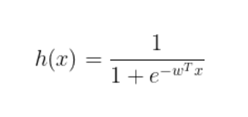
Logistic regression is one of the machine learning algorithm used for classification.
2. This is the sigmoid function that is used in logistic regression
4. It is used to make the value of the input between 0 and 1(inclusive)
3. w is the parameters used and x is the input

Slide 6
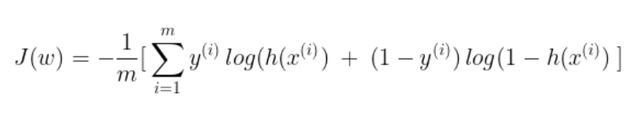
The above is the loss function for the logistic regression where y(i) is the ground truth of the data.
The loss function value must be minimum for a better model. So,we use gradient descent method to update the parameters of the model.

Slide 7
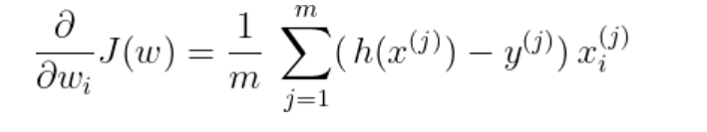
This is the result of applying the gradient descent on the loss function.
CASE II: For class label = 1
h(x) will try to produce results as close 1 as possible. As such, wT.x will be as large as possible and Wi will tend to +infinity
When we try to find the value of h(x) we can observe that:
CASE I: For class label = 0
h(x) will try to produce results as close 0 as
possible. As such, wT.x will be as small as possible and Wi will tend to -infinity

Slide 8
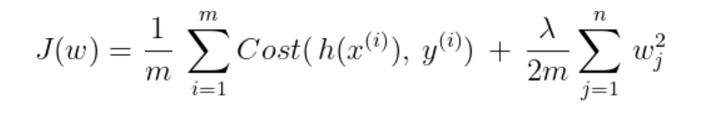
This leads to a problem called overfitting that means the model cannot generalize well i.e, it will not predict the correct class for unseen data.
We can use Regularization to overcome overfitting problem.
Let’s apply L2 regularization.
The new loss function after applying L2 Regularization is shown as below:
where lambda - regularization parameter and it controls the trade-off between the 2 goals
:fitting the training data well vs keeping the params small to avoid overfitting.

Slide 9
Regularization can improve the performance and accuracy of your logistic regression model by reducing overfitting and underfitting.
Regularization can also help you deal with multicollinearity, which is a situation where some of your input variables are highly correlated with each other.
Multicollinearity can cause instability and inefficiency in your model, as well as misleading interpretations of the coefficients. Regularization can reduce the impact of multicollinearity by shrinking or eliminating the coefficients of the correlated variables.
WHAT ARE THE BENEFITS OF USING REGULARIZATION IN LOGISTIC REGRESSION

Slide 10
THANKS
FOR WATCHING
vadlasreenija@gmail.com
Vadla Sreenija

